Slide 1
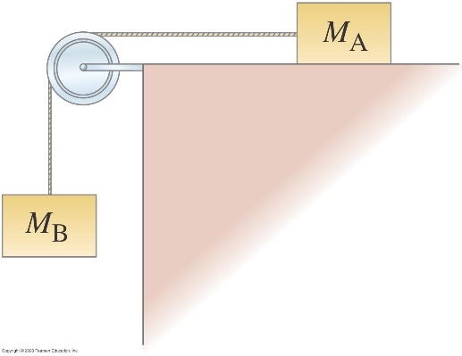
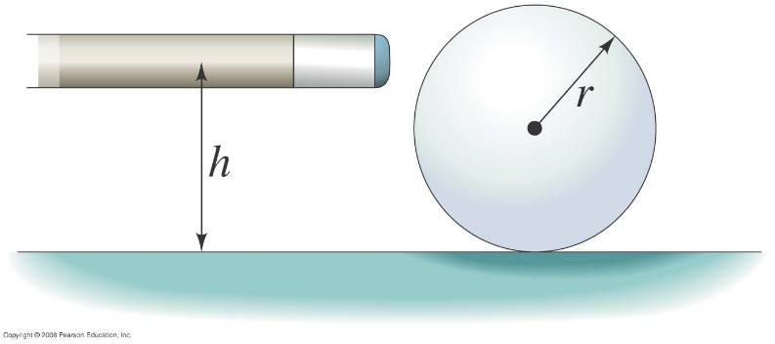
Homework 9 (Chap 10-11)
1. Fig. 1 shows two masses connected by a cord passing over a pulley of radius R₀ and moment of inertia I. Mass M_{A} slides on a frictionless surface, and M_{B} hangs freely. Determine the acceleration of the masses.
F
θ
R
r
Fig. 1
θ
Fig. 3
Fig. 2
2. In Fig. 2, if a billiard ball is hit in just the right way by a cue stick, the ball will roll without slipping immediately after losing contact with the stick. Consider a billiard ball (radius r, mass M) at rest on a horizontal pool table. A cue stick exerts a constant horizontal force F on the ball for a time t at a point that is a height h above the table’s surface (see the figure below). Assume that the coefficients of kinetic ­friction and the static friction between the ball and table are μ_{k} and μ_{S ,} respectively. Determine the range for h so that the ball will roll without slipping immediately after losing contact with the stick.
3. As shown in Fig. 3, on an inclined surface, a dumbbell with outer diameter R and inner diameter r (r = 3/5R) is pulled by a force F with a string winded around its inner post. Give that the inclined angle of the surface θ = 37∘, m the mass of the dumbbell, the moment of inertia of the dumbbell I_{c} = 4/5 mR², the static friction coefficient μ_{s} = 3/5. For a given magnitude of force F that makes the dumbbell to execute pure roll motion, draw the free-body diagram and determine the direction and magnitude of the acceleration of the dumbbell, and the friction force.

Slide 2
1. Fig. 1 shows two masses connected by a cord passing over a pulley of radius R₀ and moment of inertia I. Mass M_{A} slides on a frictionless surface, and M_{B} hangs freely. Determine the acceleration of the masses.
y
y
y
y
N_{A}
T_{B}
T_{A}
x
T_{A}
x
x
x
M_{A} g
T_{B}
M_{B} g
From the freebody diagram of M_{A}, we have
(1)
The physical relation between a_{A}, a_{B}, and α is (for α, the positive direction is counter clockwise)
(2)
From the freebody diagram of M_{B}, we have
(6)
(3)
From (1),(4),(5), and (6) we get
(4)
From the freebody diagram of the pulley, we have
(5)

Slide 3
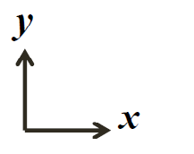
Problem 1 (solution 1, +torque for rollin to the same direction as a)
If a billiard ball is hit in just the right way by a cue stick, the ball will roll without slipping immediately after losing contact with the stick. Consider a billiard ball (radius r, mass M) at rest on a horizontal pool table. A cue stick exerts a constant horizontal force F on the ball for a time t at a point that is a height h above the table’s surface (see the figure below). Assume that the coefficients of kinetic ­friction and the static friction between the ball and table are μ_{k} and μ_{S ,} respectively. Determine the range for h so that the ball will roll without slipping immediately after losing contact with the stick.
Roll without slipping ➔
➔
➔
➔
➔
➔
➔
➔
+ torque for rolling to the same direction as a

Slide 4
Problem 1(solution 2, direction of torque and the angular acceleration follows the coordinate system of the free body diagram)
If a billiard ball is hit in just the right way by a cue stick, the ball will roll without slipping immediately after losing contact with the stick. Consider a billiard ball (radius r, mass M) at rest on a horizontal pool table. A cue stick exerts a constant horizontal force F on the ball for a time t at a point that is a height h above the table’s surface (see the figure below). Assume that the coefficients of kinetic ­friction and the static friction between the ball and table are μ_{k} and μ_{S ,} respectively. Determine the range for h so that the ball will roll without slipping immediately after losing contact with the stick.
Roll without slipping ➔
➔
➔
➔
➔
➔
➔
➔

Slide 5
2.As shown in Fig. x, on a inclined surface, a dumbbell with outer diameter R and inner diameter r (r = 3/5R) is pulled by a force F with a string winded around its inner post. Give that the inclined angle of the surface θ = 37∘, m the mass of the dumbbell, the moment of inertia of the dumbbell I_{c} = 4/5 mR², the static friction coefficient μ_{s} = 3/5. For a given magnitude of force F that makes the dumbbell to execute pure roll motion , draw the free-body diagram and determine the direction and magnitude of the acceleration of the dumbbell, and the friction force. (sin37∘ = 3/5)
y
F
x
(1)
θ
(1) →
(5)
N
(3),(4) →
f
θ
mg
(6)
(5),(6) →
x:
(1)
in x-direction,
(7)
y:
(2)
(6),(7) →
z:
(3)
For pure roll,
(4)
(8)

